Slide 1
What is a heap
Shane Mrad

Slide 2
In computer science, a heap is a specialized tree-based data structure that satisfies the heap property
Heap (data structure). (2023, October 20). In Wikipedia. https://en.wikipedia.org/wiki/Heap_(data_structure)

Slide 3
WHO MADE HEAP?
The heap data structure, specifically the binary heap, was introduced by J. W. J. Williams in 1964, as a data structure for the heapsort sorting algorithm

Slide 4
What is heapify
Heapify is an algorithm that converts a binary tree into a heap. A heap is a complete binary tree where the value of each node is greater than or equal to the value of its parent. Heapify can be implemented in a variety of ways, but one common approach is to use a recursive algorithm.

Slide 5
heap order property
A heap is a complete binary tree, whose entries satisfy the heap ordering property. The heap ordering property states that the parent always precedes the children. There is no precedence required between the children. The precedence must be an order realtionship.

Slide 6
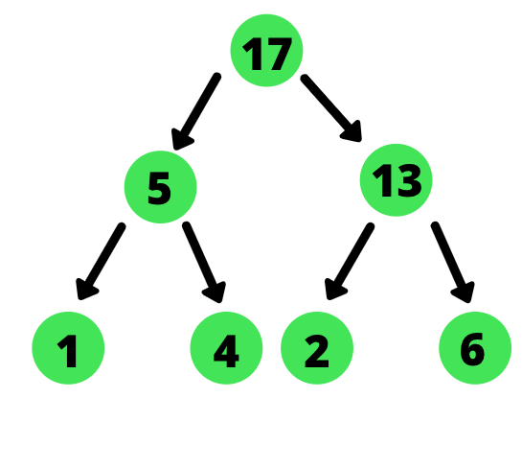
What is a max-heap
A max heap is a complete binary tree in which the value of a node is greater than or equal to the values of its children. Max Heap data structure is useful for sorting data using heap sort.

Slide 7
What, how and when to percolate down
Starting with the last node that is not a leaf node, compare it with its left and right children. Interchange the node with the larger of its two children. Continue this process with the node until it becomes a leaf node or until the heap property is restored. This is known as the percolate down process.
Move the last tree node to the root.
Reduce the tree size by 1
Percolate down from the root node.

Slide 8
What is, how to, and when to percolate up
You compare the value of the newly inserted element with its parent.
If the element is smaller than its parent (in the case of a min heap), you swap the element with its parent.
You continue this process until the heap property is restored (the element is no longer smaller than its parent, or it becomes the root).

Slide 9
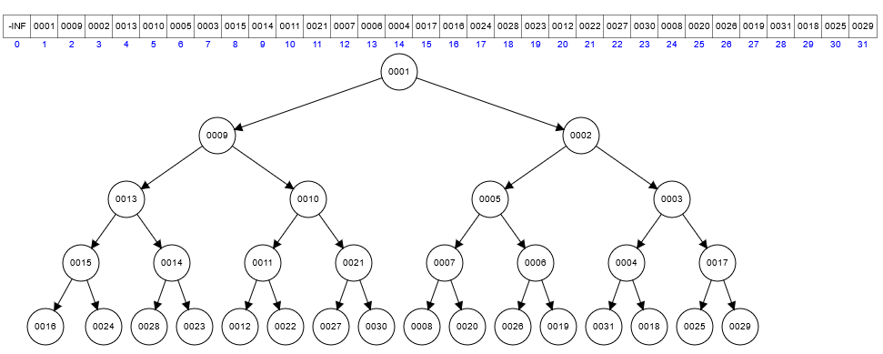
How to delete a value - show the before and after array
https://www.cs.usfca.edu/~galles/visualization/Heap.html

Slide 10
How to insert a new value - show the before and after array
Step 1: Insert the new value at the bottom-right of the heap
Step 2: Percolate Up to restore the min heap property
Before Percolate Up: [10, 15, 30, 40, 50, 40, 35, 20]
After Percolate Up (1st step): [10, 15, 20, 40, 50, 40, 35, 30]

Slide 11
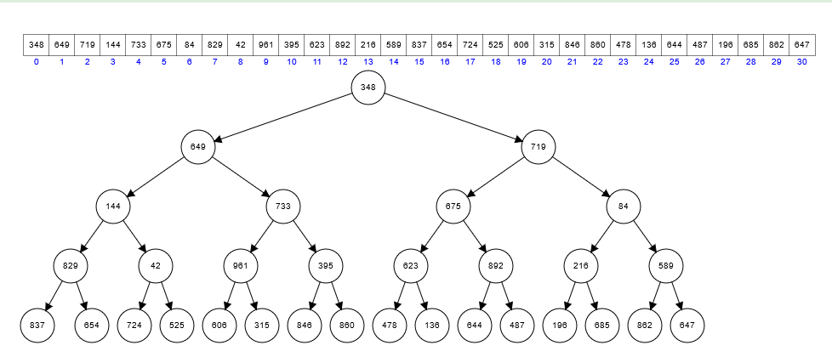
How to do heapsort - showing the before and after array
https://www.cs.usfca.edu/~galles/visualization/HeapSort.html

